Slide 1




MLOps IA is above all a human adventure
Guillaume Chervet
TechLead – ML Engineer @guiChervet

Slide 2
Software
Data
Ops

Slide 3
Email classification
Training env. (AzureML) | Production env. (OpenShift) | Total default run cost
2700 € / month | 6000 € / month (dev, staging, pre-prod, prod) | 8 700 € / month
Notes:
On parle de 3 000 000 mail par ans
10 000 jours
250 000 mois
3 centime la classification de mail
40 000 Euros environ pour un réentrainement par ans donc environ 1 centime plus soit 4 centime
150 000 Euro par ans
Sachant que les taux de prédictions ne sont pas parfait => cout induit
Plus cout de gestion de la production
POC 300 000 Euros
1, 2 millions de projet si 5 personnes a temps plein sur 2 ans
Projet sans annotation => on est parti d’un système qui classifie déjà apprentissage sur 55 000 mails cout annotation 300 / jours 183 jour * 300 => 55 000 € euros

Slide 4

Classification
Claims Contract
Invoice
Attachment
Other
email
"envelope upside an old white paper"

Slide 5
Introduction to AI and Deep Learning
What do we expect from a project in production?
How to stack the odds in your favor?

Slide 6
Deep Learning
Artificial Intelligence
Machine Learning
Deep Learning

Slide 7
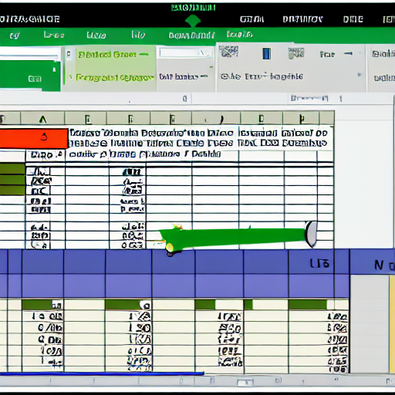
Deep Learning
Structured data
"excel structured data"

Slide 8


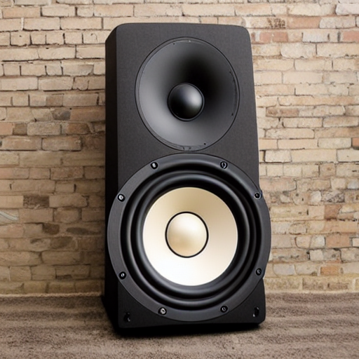
Deep Learning
Unstructured data
"text from an old book on a table"
"camera outside on the beach"
"big music speaker"

Slide 9


Deep Learning
Classical programming
Rules
Answers
Data
Machine Learning
Data
Rules
Answers
Source : François Chollet

Slide 10
Deep Learning
Code
Input
Output
AI model
Input
Output

Slide 11

Data is gold
Deep Learning
(Data centric)

Slide 12
Deep Learning
Configuration
Data Collection
Data Verification
Machine Resource Management
Serving Infrastructure
Monitoring
ML Code
Analysis Tools
Feature Extraction
Process Management Tools
Source : Google, The Hidden Technical Debt In Machine Learning Systems

Slide 13

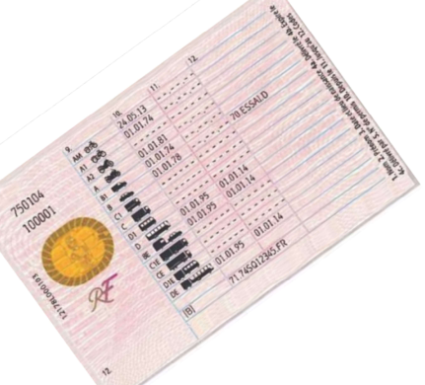




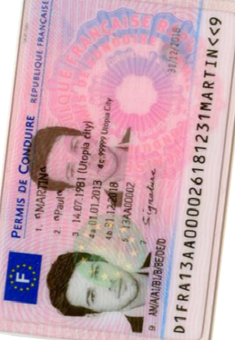
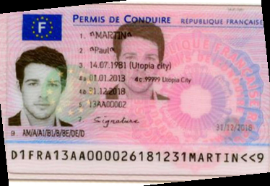
Production
Page
Zoning
Homography
Zoning
Zoning
OCR
OCR
Split
Split
Zoning
Homography
Zoning
OCR
Legend :
ML + code
Only code
Notes:
Guillaume
10 mins

Slide 14
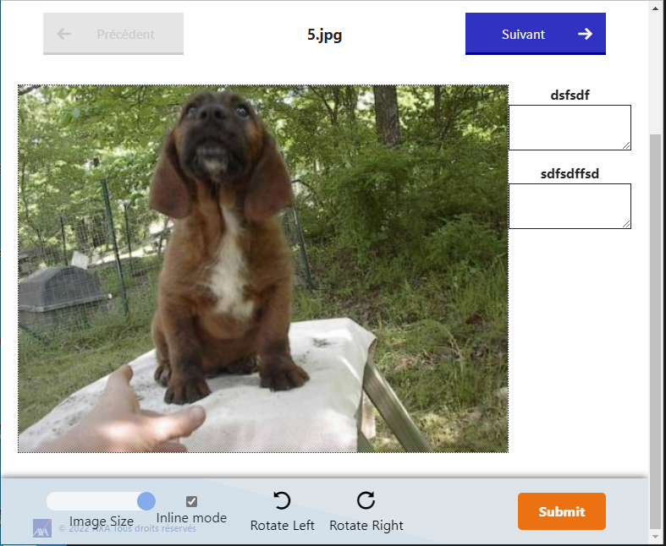
Ecotag
Deep Learning
collect
Datasets
use
Train AI
deploy
Production AI API
use
Consumer Production application
collect
Feedback Loop

Slide 15
Introduction to AI and Deep Learning
What do we expect from a project in production?
How to stack the odds in your favor?

Slide 16
Production
Answer users’ needs
Accurate AI predictions
Cheap
Fast
Secured
Monitored (data drift)
Fast retrain/deployment

Slide 17
Pain points
Production

Slide 18

PDF, IMAGES
JSON Response
OCR
Input HTTP call
HTTP Callback
Receiver
Orchestrator
Queue
New license - frontside
Queue
Homography
Zoning
Queue
Queue
Splitter
Table Zoning
New license - backside
Queue
Homography
Zoning
Table Rotation
Queue
Queue
Queue
Zoning
Queue
Old license - frontside
Homography
Zoning
Table Classifier
Table Rotation
Queue
Queue
Queue
Queue
Production

Slide 19
Quicker response
Production : Pain points
Better prediction
Cheaper

Slide 20

Spot 7 differences
Production : Pain points

Slide 21
Introduction to AI and Deep Learning
What do we expect from a project in production?
How to stack the odds in your favor?

Slide 22
IA future is going to be a huge :
Human transformation
Organization transformation
Information System Architecture transformation

Slide 23

Conclusion
"three people hugging"

Slide 24

Thank you ☺
"thank and hug the public in a theater"

Slide 25
PDF, IMAGES
Orchestrator
Receiver
Pdfs,images
Ocr
Vers le hub
(callback ou kafka)
Queue
Queue
Splitter
Queue
Extract-eml
Enrichment
Prediction Ramiv2
Queue
Queue
Text-extract
Queue
doc, docx, xlsx..

Slide 26

Exploration phase

Slide 27
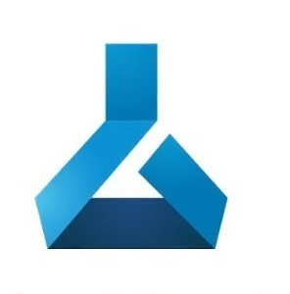




Exploration phase
AzureML dev
Annotations
+
Data
Automated Training Pipeline
Data Validation
Data Preparation
Model Training
Model Evaluation
Model Registry
Model Register

Slide 28

Exploration phase
AzureML dev
Annotations
+
Data
Automated Training Pipeline
Data Validation
Data Preparation
Model Training
Model Evaluation
Model Registry
Model Register

Slide 29
Exploration phase
AzureML dev
Annotations
+
Data
Automated Training Pipeline
Data Validation
Data Preparation
Model Training
Model Evaluation
Model Registry
Model Register
Estimate AI metrics
Estimate production cost
Estimate response time
Train code + Data

Slide 30
Production phase

Slide 31
Production phase
AzureML dev
Automated Training Pipeline
Data Validation
Data Preparation
Model Training
Model Evaluation
Model Registry
Model Register

Slide 32

Production phase
AzureML dev
Automated Training Pipeline
Data Validation
Data Preparation
Model Training
Model Evaluation
Model Registry
Model Register
Docker registry

Slide 33


Production phase
AzureML dev
Automated Training Pipeline
Data Validation
OpenShift dev
Data Preparation
Model Training
zoning
ocr
homography
Model Evaluation
Model Registry
Model Register
OpenShift rec
zoning
ocr
homography
Docker registry

Slide 34
Production phase
AzureML dev
Automated Training Pipeline
Data Validation
OpenShift dev
Data Preparation
Model Training
zoning
ocr
homography
Model Evaluation
Model Registry
Model Register
OpenShift rec
zoning
ocr
homography
Docker registry

Slide 35
Production phase
AzureML dev
Automated Training Pipeline
Data Validation
OpenShift dev
Data Preparation
Model Training
zoning
ocr
homography
Model Evaluation
Model Registry
Model Register
OpenShift rec
zoning
ocr
homography
OpenShift pre-prod
Docker registry
AzureML prod
zoning
ocr
homography
Automated Training Pipeline
OpenShift prod
Data Validation
Data Preparation
Model Training
zoning
ocr
homography
Model Evaluation
Model Registry
Model Register

Slide 36
Production phase
AzureML dev
Automated Training Pipeline
Data Validation
OpenShift dev
Data Preparation
Model Training
zoning
ocr
homography
Model Evaluation
Model Registry
Model Register
OpenShift rec
zoning
ocr
homography
OpenShift pre-prod
Docker registry
AzureML prod
zoning
ocr
homography
Automated Training Pipeline
OpenShift prod
Data Validation
Data Preparation
Model Training
zoning
ocr
homography
Model Evaluation
Model Registry
Model Register

Slide 37
Production phase
AzureML dev
Automated Training Pipeline
Data Validation
OpenShift dev
Data Preparation
Model Training
zoning
ocr
homography
Model Evaluation
Model Registry
Model Register
OpenShift rec
zoning
ocr
homography
OpenShift pre-prod
Docker registry
AzureML prod
zoning
ocr
homography
Automated Training Pipeline
OpenShift prod
Data Validation
Data Preparation
Model Training
zoning
ocr
homography
Model Evaluation
Model Registry
Model Register

Slide 38
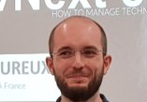
Production phase
AzureML dev
Automated Training Pipeline
Data Validation
OpenShift dev
Data Preparation
Model Training
zoning
ocr
homography
Model Evaluation
Model Registry
Model Register
OpenShift rec
zoning
ocr
homography
OpenShift pre-prod
Docker registry
AzureML prod
zoning
ocr
homography
Automated Training Pipeline
OpenShift prod
Data Validation
Data Preparation
Model Training
zoning
ocr
homography
Model Evaluation
Model Registry
Model Register

Slide 39
Production phase
AzureML dev
Automated Training Pipeline
Data Validation
OpenShift dev
Data Preparation
Model Training
zoning
ocr
homography
Model Evaluation
Model Registry
Model Register
OpenShift rec
zoning
ocr
homography
OpenShift pre-prod
Docker registry
AzureML prod
zoning
ocr
homography
Automated Training Pipeline
OpenShift prod
Data Validation
Data Preparation
Model Training
zoning
ocr
homography
Model Evaluation
Model Registry
Model Register

Slide 40
Dataset of 20 000 files
Deep Learning
Train a model
13 000 train
4 000 test
3 000 validation

Slide 41

Data drift
Deep Learning
"a race car drift deep on a road in a bend"

Slide 42

Deep Learning
"the god graal trophy"
Notes:
C’est quoi le graal ?

